Slide 1

Equal Employment Opportunity
Responsibilities of Federal Procurement Officers: An Update
Presented by the Office of Federal Contract Compliance Programs (OFCCP)
2015, February 18
Notes:
Speaker Notes: Brenda
Welcome everyone! My name is Brenda Williams-Stewart, I am with the Office of Federal Contract Compliance Programs or OFCCP. I am your moderator for today’s presentation on the Responsibilities of Federal Procurement Officers. I want to thank the Federal Acquisition Institute (better known as FAI) for the working with OFCCP in this joint effort to provide you with important information.
I have with me today several OFCCP officials who are going to review with you the equal employment opportunity requirements associated with federal contracting and the related obligations of procurement and contracting officers. During today’s presentation we will also update you on recent changes to our program.
We welcome your questions throughout the presentation so please send them in and we will answer as many as possible at the end of our session.
Next Slide: Debra Carr

Slide 2

Office of Federal Contract Compliance Programs (OFCCP)
Debra Carr
Director, Division of Policy and Program Development
OFCCP
Department of Labor
Notes:
Speaker Notes:
To begin our presentation, I take great pleasure in introducing you to Debra Carr, who serves as the Director of the Division of Policy and Program Development (or Policy) for OCCP at the U.S. Department of Labor in Washington, DC. She leads the Policy’s two branches: Branch of Regulatory, Legislative and Policy Development, and the Branch of Training, Education and Program Development.
Ms. Carr joined OFCCP after serving as Associate Deputy Staff Director for the U.S. Commission on Civil Rights (USCCR) and, before that, as its General Counsel. While at USCCR, Ms. Carr wrote several vital reports with important policy ramifications including: an evaluation of the Native American healthcare system and the need to reauthorize the Indian Healthcare Improvement Act; an assessment of the effectiveness of the No Child Left Behind Act; and a review of the usefulness of Executive Order 12898 and Title VI as tools for achieving environmental justice.
Before joining USCCR, Ms. Carr distinguished herself as a civil rights lawyer at the Department of Justice (DOJ) by handling some of this country’s most difficult and heinous violations of federal criminal civil rights statutes.
Ms. Carr headed a White House office and represented the U.S. at the United Nations on issues related to racism and xenophobia. She also participated in the preparation of the government’s report to the U.N Committee on the Elimination of Racial Discrimination.
I’ll now turn the presentation over to Debra for opening remarks. Welcome Debra.

Slide 3
Presenters
Melissa L. Speer, Regional Director Southwest and Rocky Mountain Region (SWARM)
Herman Narcho, Branch Chief for Enforcement, Division of Program Operations, National Office, OFCCP
OFCCP - An Update, February 18, 2015
Notes:
Speaker Notes: Brenda
Thank you Debra.
Also joining us today are two OFCCP representatives that bring many years of experience in enforcing civil rights laws and ensuring contractor compliance.
Melissa L. Speer, is the Regional Director for OFCCP’s Southwest and Rocky Mountain Region (SWARM). She provides leadership for more than 91 employees spanning 11 states and 7 offices. She has been making workplaces fairer since she came to OFCCP in 1989. She began her career as a Compliance Officer in our Little Rock Area office and has worked throughout the SWARM Region as a Liaison Officer, District Director in Dallas, Director of Regional Operations and Deputy Regional Director. Ms. Speer received a Bachelors of Science in Accounting from the University of Arkansas at Little Rock in 1988 and Masters of Business Administration from the University of Arkansas at Little Rock in 1991.
In addition, we also have Herman Narcho from OFCCP’s Branch Chief for Enforcement. He is located in the National Office and began his career with OFCCP in February 2014. Prior to his move to OFFCP, Herman had over 20 years of experience at DOL’s Office of the Solicitor (SOL), where he provided legal advice on procurement, appropriation and intellectual property issues as well as litigated bid protest and contract claim cases.
During his tenure at SOL, Herman also provided legal advice to SOL's Mine Safety and Health Division drafting and reviewing safety regulations for the Mine Safety and Health Administration and providing legal advice to all areas of DOL's Employment and Training Administration. He also has managed legislative and departmental communications between DOL, Congress and OMB. He was a law clerk to Judge Robert H. Hodges of the U.S. Court of Federal Claims and is a graduate of Georgetown Law School and Dartmouth College.
Welcome Melissa and Herman.
Melissa, I’ll turn the presentation over to you.
Next Slide: Agenda

Slide 4
Agenda
Introduction to OFCCP
Relationship to the Federal Acquisition Regulations (FAR)
Responsibilities of Federal Contracting and Procurement Officers
OFCCP - An Update, February 18, 2015
Notes:
Speaker Notes: Melissa
Thank you Brenda and I want to thank the Federal Acquisition Institute for giving us the opportunity to speak with a very important segment of our stakeholders – federal procurement and contracting officers.
During today’s presentation we would like to introduce you to the Office of Federal Contract Compliance Programs (OFCCP): what we, as a federal agency do, the laws we enforce, and how we enforce them. We will also discuss which contractors are covered.
We will discuss how the regulations we enforce interact with the federal acquisition regulations (FAR), the rules that regulate your work and the general responsibilities of contracting officers at the solicitation for offers/bidders during the pre and post award of a contract. We’ll provide an overview of the pre-award process, which is one of the more important responsibilities of procurement officers.
Throughout the presentation we will incorporate recent changes to the laws enforced by OFCCP and how it impacts or relates to your responsibilities as a contracting/procurement officer.
So, what is OFCCP?
Next Slide: What is OFCCP?

Slide 5
What is OFCCP?
A federal civil rights agency enforcing laws prohibiting covered federal contractors from discriminating in employment on the basis of race, color, religion, sex, sexual orientation, gender identity, national origin, disability, or status as a protected veteran
OFCCP - An Update, February 18, 2015
Notes:
Speaker Notes: Melissa
OFCCP is an agency within the U.S. Department of Labor that enforces laws prohibiting employment discrimination by federal contractors and subcontractors.
Federal contractors and subcontractors – are those employers that are doing business with the federal government. This includes all types of businesses: construction, manufacturers, banks, leasing companies and so on. The laws enforced by OFCCP prohibit covered federal contractors from discriminating in employment on the basis of race, color, religion, sex, sexual orientation, gender identity, national origin, disability or status as a protected veteran and require those contractors to engage in affirmative action.
Next Slide: OFCCP’s Six Regions - Map

Slide 6
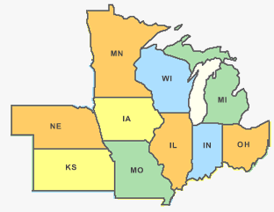
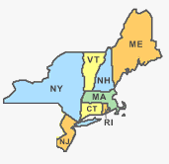
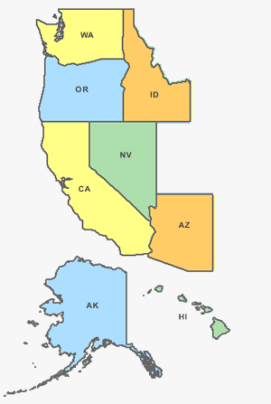

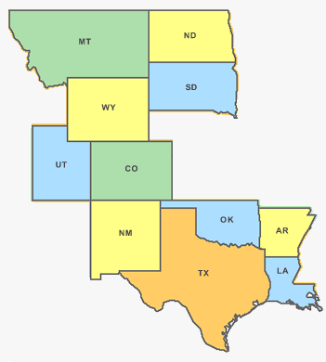
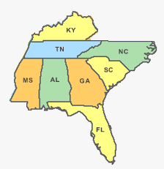
OFCCP’s Six Regions
Northeast
Midwest
Mid-Atlantic
SWARM
Pacific
Southeast
OFCCP - An Update, February 18, 2015
Notes:
Speaker Notes: Melissa
OFCCP is made up of a national office in Washington, DC, six regional offices nationwide and 49 district and area offices in major metropolitan areas throughout
the US, including Puerto Rico and Guam.
As federal procurement officers your primary point of contacts will be with our Regional Offices located in Dallas, San Francisco, Chicago, New York,
Philadelphia, and Atlanta. Generally speaking, procurement officers contact our regional offices through the pre-award monitor. We’ll discuss that process later
in this presentation.
Next Slide: What are the Laws OFCCP Enforces?

Slide 7
What are the Laws OFCCP Enforces?
Executive Order 11246, as amended
Section 503 of the Rehabilitation Act of 1973, as amended
Vietnam Era Veterans’ Readjustment Assistance Act (VEVRAA) of 1974, as amended
OFCCP - An Update, February 18, 2015
Notes:
Speaker Notes: Melissa
OFCCP enforces the civil rights laws that protect applicants and employees of federal contractors, subcontractors, and federally assisted construction contractors and subcontractors. The laws are:
Executive Order 11246, which prohibits discrimination on the basis of race, color, religion, sex, sexual orientation, gender identity, and national origin
Section 503 of the Rehabilitation Act of 1973, which prohibits discrimination on the basis of disability, and the
Vietnam Era Veterans’ Readjustment Assistance Act of 1974 (VEVRAA) which prohibits discrimination on the basis of status as a protected veteran.
I want to take a moment to highlight some recent changes in each of these laws.
Recently, Executive Order 11246 was amended to include the prohibition against employment discrimination based on sexual orientation and gender identity. This amendment to the Executive Order goes into effect on April 8, 2015 and applies to covered federal contracts and subcontracts that are entered into or modified on or after April 8, 2015. In terms of what contracting officers need to do – the Executive Order equal opportunity clause was amended to include sexual orientation and gender identity. When we discuss the equal opportunity clauses, we’ll highlight where it is inserted.
In addition, OFCCP has published two Notices of Proposed Rulemaking. The first will prohibit covered contractors from disciplining employees for discussing or disclosing their pay and the second will require covered contractors to provide an annual report on the compensation paid to employees. The prohibition on pay secrecy policies also impacts the equal opportunity or EO clause by adding a new paragraph to the clause. When the rules are finalized, the EO clause will be revised in covered contracts issued on or after the effective date of those rules.
Another significant change we made was in March of last year. We published new regulations implementing the requirements of Section 503 of the Rehabilitation Act and the Vietnam Era Veterans’ Readjustment Assistance Act. This was the first major change for both rules since the 1970’s. The changes were made to update the regulations to reflect current practices and legal standards as well as to ensure a more proactive approach to ensuring individuals with disabilities and protected veterans have an equal opportunity in employment with federal contractors and subcontractors. Contractors are now in the process of coming into compliance with the new requirements that include self-identification of applicants and employees, goals and hiring benchmarks, and data collection. If these questions come to you as procurement officers we ask that you refer the contractors to either our Web site or our Help Desk so we can provide them with the information that they need to comply.
The laws that OFCCP enforces are found in the Code of Federal Regulations at Title 41, Chapter 60. The requirements related to procurement officers are incorporated into the Federal Acquisition Regulations or FAR.
So which contractors are covered?
Next Slide: Who is covered?

Slide 8
Who is Covered?
Executive Order 11246
Contracts and subcontracts in excess of $10,000
Non-construction employers with contracts of $50,000 or more and 50 or more employees must develop and maintain a written Affirmative Action Program
OFCCP - An Update, February 18, 2015
Notes:
Speaker Notes: Melissa
There are specific thresholds associated with OFCCP’s jurisdiction.
For Executive Order (EO) 11246 a contract is covered if it is in excess of $10,000.
In addition, non-construction or supply and service contractors with a contract or contracts of $50,000 or more and who have 50 or more employees must also develop and maintain written affirmative action programs (AAPs).
Contractors must comply with specific affirmative action requirements, including outreach and recruitment efforts, self-monitoring of their employment practices, the identification and correction of discriminatory practices, and the identification and removal of any barriers to equal employment opportunity.
Next Slide: Who is covered? Section 503

Slide 9
Who is Covered?
Section 503
Contracts and subcontracts in excess of $15,000
Contractors with contracts of $50,000 or more and 50 or more employees must develop and maintain a written Affirmative Action Program
OFCCP - An Update, February 18, 2015
Notes:
Speaker Notes: Melissa
Section 503 of the Rehabilitation Act applies to contracts and subcontracts in excess of $15,000. You may have been familiar with the previous threshold of $10,000. This threshold is affected by an adjusted inflation rate and was raised to $15,000.
In addition, contractors with contracts in of $50,000 or more and who have 50 or more employees must also develop and maintain written affirmative action programs (AAPs). Unlike the Executive Order 11246, this requirement for a written affirmative action program applies to both non-construction and construction contractors.
Next Slide: Who is covered? VEVRAA

Slide 10
Who is Covered?
VEVRAA
If the contract is $100,000 or more, contractors are subject to VEVRAA
If the contractor has 50 or more employees, they are required to develop and maintain an Affirmative Action Program
OFCCP - An Update, February 18, 2015
Notes:
Speaker Notes: Melissa
VEVRAA applies to contracts of $100,000 or more.
Contractors with 50 or more employees are required to develop and maintain written affirmative action programs. Like Section 503, this obligation applies to both construction and non-construction contracts.
The protections of VEVRAA apply to protected veterans which are defined as disabled veterans (determined as those who receive disability compensation from the VA, or would be eligible, but for retired military pay), recently separated veterans, veterans who served on active duty during a war or campaign when a badge was authorized, and veterans who participated in a U.S. military operation that received an Armed Forces service medal.
Next Slide: What Does OFCCP Do?

Slide 11

What Does OFCCP Do?
Conducts compliance evaluations
Investigates discrimination complaints
OFCCP - An Update, February 18, 2015
Notes:
Speaker Notes: Melissa
To ensure contractors comply with these laws, OFCCP conducts its civil rights enforcement responsibilities in a number of ways:
OFCCP conducts compliance evaluations of contractors and subcontractors, even when no discrimination complaint has been filed.
To take a hard look at the company’s employment policies and practices, including practices related to hiring, testing, promotions, compensation, and termination, to ensure that discrimination has not occurred.
To do this, we review the contractor’s AAP and other records, and,
We may also decide to go onsite to the contractor facility and interview managers and employees, among other things.
OFCCP investigates complaints of discrimination filed by individuals or groups and deals exclusively with employers that are federal contractors. Only the laws OFCCP enforce require affirmative action by covered contractors to ensure that all are provided with equal employment opportunity. We also work closely with the Equal Employment Opportunity Commission or EEOC to ensure that there is no duplication of efforts by our respective agencies, and to ensure that any misfiled complaints are promptly redirected to the correct agency.
Next Slide: What Does OFCCP Do?

Slide 12
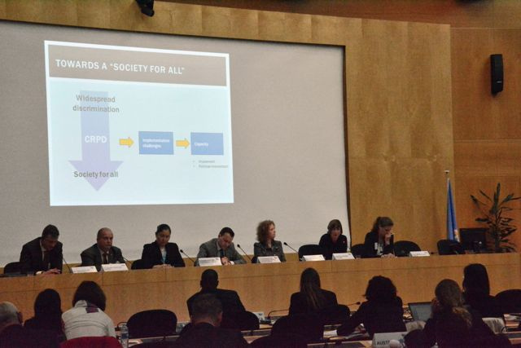
What Does OFCCP Do?
Provides technical assistance
Engages in outreach and public education
OFCCP - An Update, February 18, 2015
Notes:
Speaker Notes: Melissa
In addition to conducting compliance evaluations and investigating complaints, OFCCP provides free compliance assistance to contractors to assist them in complying with the laws OFCCP enforces, including workshops on different topics such as guidance for new contractors, how to develop an AAP, and, of course, on any new regulations.
OFCCP also educates community based organizations and members of the public to facilitate understanding of, and compliance with, the laws we enforce. This might include events in which organizations are invited to attend to assist in building collaboration between contractors and organizations serving people with disabilities and veterans.
Next Slide: Federal Acquisition Regulations (FAR)

Slide 13
Federal Acquisition Regulations (FAR)
Equal Employment Opportunity (EEO) requirements are incorporated into the FAR
Set of regulations governing all acquisitions and contracting procedures in the federal government
https://acquisition.gov/far/index.html
OFCCP - An Update, February 18, 2015
Notes:
Speaker Notes: Herman
As we explained earlier, OFCCP’s regulations are codified in the Code of Federal Regulations at Title 41, Chapter 60. In addition, the requirements related to procurement officers are incorporated into the Federal Acquisition Regulations (FAR) which is the set of regulations governing all acquisitions and contracting procedures in the federal government.
As many of you may be aware, the FAR is designed to provide a common set of regulations and procedures for acquisitions to be used throughout the federal government. It contains an overall structure and broad procedures for the government to use when purchasing goods and services.
Next Slide: FAR

Slide 14
Federal Acquisition Regulations (FAR)
FAR 22.8 Equal Employment Opportunity
FAR 22.804 Affirmative Action Programs
Non-construction
Construction
FAR 22.805 Procedures
OFCCP - An Update, February 18, 2015
Notes:
Speaker Notes: Herman
The Equal Employment Opportunity requirements derived from Executive Order 11246 are found in the FAR at 22.8. These regulations address the requirements for procurement officers as they relate to incorporating EEO into contracts and the contract process.
It includes the affirmative action requirements for construction and nonconstruction or supply and service contractors found at 22.804 and contracting procedures found at FAR 22.805 including pre-award clearances which we will be discussing.
Next Slide: Responsibilities of Federal Contracting and Procurement Officers

Slide 15
Federal Acquisition Regulations (FAR)
Subpart 22.13 – Equal Opportunity for Veterans – prescribes policies and procedures for VEVRAA
Subpart 22.14 – Employment of workers with disabilities – prescribes policies and procedures for implementing Section 503
OFCCP - An Update, February 18, 2015
Notes:
Speaker Notes: Herman
In addition, the FAR includes the Section 503 and VEVRAA procedures for contracting officers. These are incorporated into the FAR, at Subparts 22.13 and 22.14.
Subpart 22.13 - This section covers a range of definitions and descriptions of veterans and discusses policies and procedures in hiring protected veterans. It also describes affirmative action requirements.
Subpart 22.14 – This section provides detail on employment of workers with disabilities, including policies and procedures for hiring workers with disabilities.
So let’s review the responsibilities and requirements. We’ll begin by breaking down the steps.
Next Slide: Responsibilities of Federal Procurement Officers

Slide 16
Responsibilities of Federal Procurement Officers
Solicitation
Pre-Award
Post-Award
OFCCP - An Update, February 18, 2015
Notes:
Speaker Notes:
Looking at the requirements and the process, contracting officers, we’ve identified three significant stages with equally significant responsibilities. These are the solicitation process the Pre-Award process, and the Post Award process.
We’ll review these stages and the specific actions or obligations of Federal Procurement and Contracting Officers in the next several slides.
Next Slide: Solicitation

Slide 17
Solicitation
Solicitation
Pre-Award
Post-Award
Include Specific Provisions in Solicitations
Attestation of Previous Contract Participation
Attestation of Filing Previous Compliance Reports
EEO-1 Report
4212 Report (formerly VETS 100/100A)
Notice of Requirement for Affirmative Action Obligations
Notice of Pre-award On-site Evaluation
OFCCP - An Update, February 18, 2015
Notes:
Speaker Notes:
When a contracting officer is putting together the request for proposal or soliciting bids for a contract, certain provisions must be included. The purpose is to give notice to all bidders that the contract is a covered contract and it includes provisions related to equal employment opportunity and affirmative action. The provisions include ensuring that facilities are not segregated, whether or not the bidder has ever been a federal contractor, and whether the contractor has provided required reports – specifically the EEO-1 Report and the annual report of veteran hiring.
The provisions also include Notification of Visa Denial, if the contractor is required to perform work in or on behalf of a foreign country.
In addition the notice provides information related to the requirement for affirmative action. For non-construction or supply and service contractors this involves the assurance that if it meets the specific thresholds it has or will be able to develop and maintain the required written affirmative action program.
An additional significant provision is the notice of pre-award onsite evaluation. This notification advises the prospective contractor that it could be the subject of a pre-award compliance evaluation, which could include an onsite during which OFCCP would examine employment policies and records and interview employees. The purpose of such an evaluation is to assess compliance with the EEO and affirmative action obligation and to provide the contractor technical assistance including information related the obligations and resources available.
For construction contractors this is the notice of the specific affirmative action provisions required of all federal construction contractors. This notice includes the goals for the geographic area in which the project is located. The affirmative action compliance provision ensures that contractors are aware of the obligations of nondiscrimination, the outreach, recruiting, training and recordkeeping obligations as well as the goals for the project. It also includes the notification that when awarded, the contractor is required to notify OFCCP of subcontracts in excess of $10,000.
So, where would you find the goals for construction projects?
Next Slide: Goals (screen shot)

Slide 18
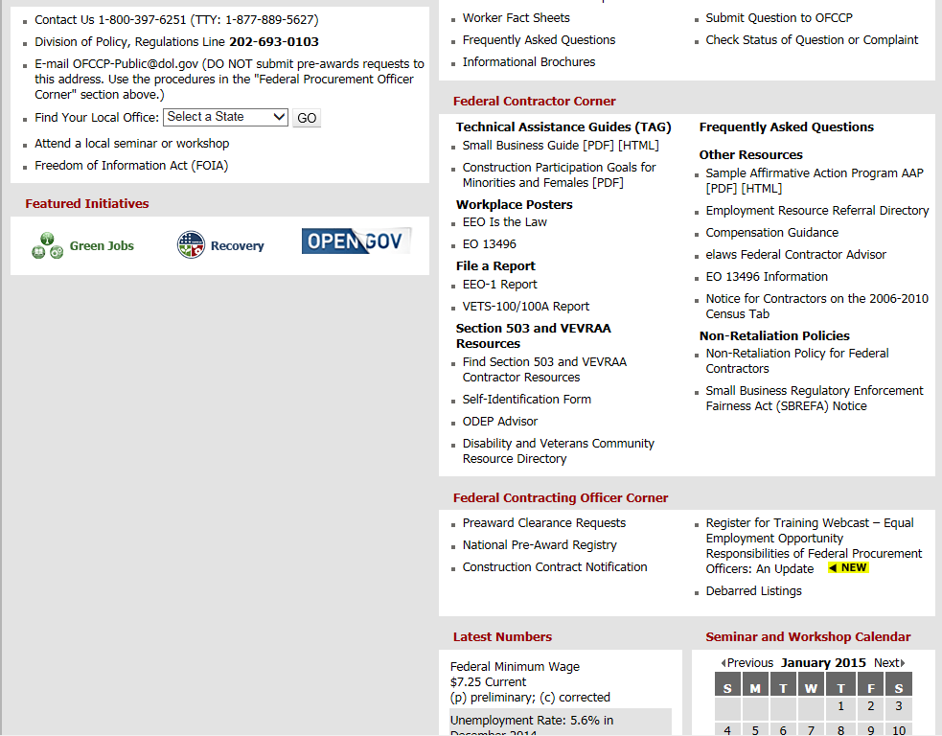
Notes:
Speaker Notes:
Construction goals are posted on OFCCP’s Web site. As a reminder, the construction goals are to be incorporated into the contract and subcontract. These are utilization goals that are focused on the construction trades. The goal for women is 6.9 percent of the hours worked and the goal for minorities varies by geographical area.
If you have questions related to the appropriate goal for a particular area, please contact the OFCCP office nearest to the location where the work will be taking place or OFCCP’s Help Desk.
Next Slide: Bidder/Offeror Requirements

Slide 19
Prospective Bidders Requirements
Solicitation
Pre-Award
Post-Award
Certify Compliance
Developed an Affirmative Action Program
Filed an EEO-1 Report
Filed a VETS-100 Report
Participated in any previous contract subject to the Equal Opportunity Clause
OFCCP - An Update, February 18, 2015
Notes:
Speaker Notes:
Agencies are required to ensure perspective contractors and certify compliance. The prospective contractors will certify whether or not they’ve participated in a previous covered contract or subcontract. In addition, the prospective contractors are required to state at the outset of the negotiations for the contract whether it has developed a written affirmative action program and has such a document on file at each of its establishments. In addition it must state whether it has filed an EEO-1 Report with the Joint Reporting Committee.
The attestations and certifications, found in the System for Award Management or SAM will show you if the contractor has certified the development of an AAP, had previous contracts and filed an EEO-1 Report.
To certify submission of the VETS 4212 Report ( formerly the VETS 100/100A Report), a contracting officer must query the Department of Labor VETS 100 database.
Next Slide: SAM

Slide 20
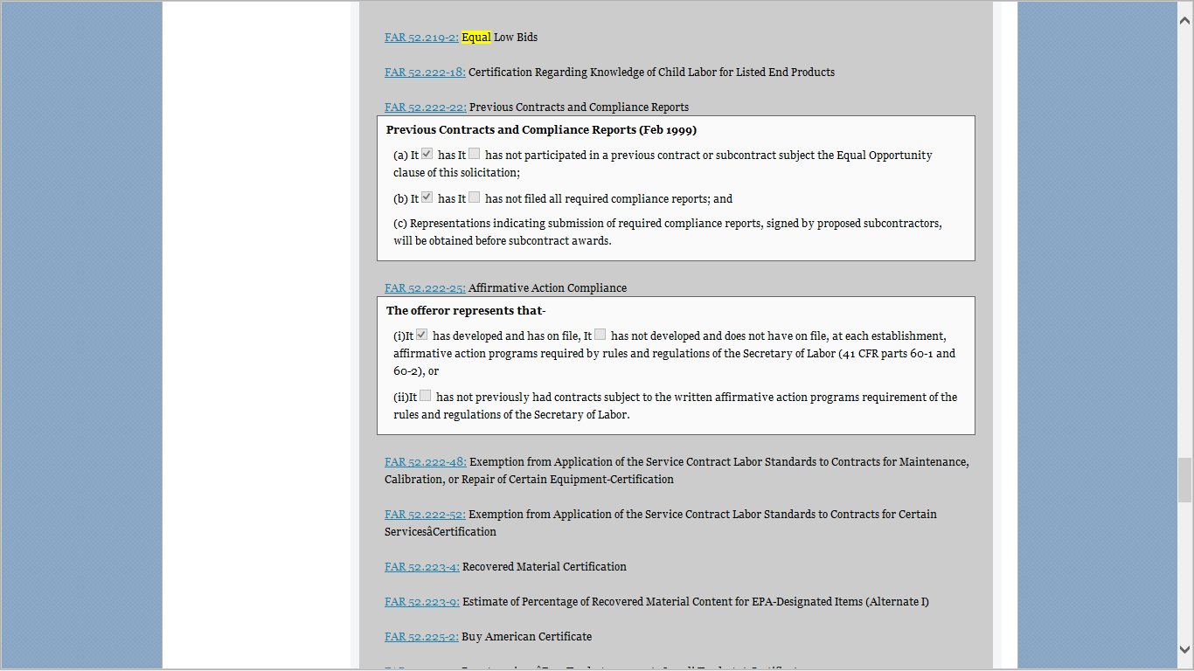
Notes:
Speaker Notes:
So you can see, on the screen is the SAM information. So when looking at bids or prospective contractors it is important to review sections. FAR 52.222-22 (the top arrow) addresses previous contracts and compliance reports. FAR 52.222-25 (the bottom arrow) addresses affirmative action compliance. In these sections you will find the certifications and attestations.
You will probably recognize this screen shot from the website for the System for Award Management or SAM.
Next slide: Question

Slide 21

Question:
Solicitation
Pre-Award
Post-Award
What resources are available to contracting officers if a bidder/offeror has questions about the equal employment opportunity and affirmative action obligations?
OFCCP - An Update, February 18, 2015
Notes:
Speaker Notes:
What resources are available to contracting officer if a bidder/offeror has questions about their obligations?
Next Slide: Answer

Slide 22
Answer:
Solicitation
Pre-Award
Post-Award
OFCCP’s Web site
OFCCP’s Help Desk
OFCCP’s Field Offices
OFCCP - An Update, February 18, 2015
Notes:
Speaker Notes:
Resources available include OFCCP’s Web site where a prospective contractor can find information on the requirements associated with federal contracting and subcontracting. Included are frequently asked questions, training webinars, information for small and new contractors and brochures. In addition, the Web site includes searchable databases of community based organizations capable of referring qualified individuals with disabilities, protected veterans, women and minorities.
OFCCP has a Help Desk available to the public. Prospective contractors can call or email the Help Desk for assistance.
Additional resources include technical assistance presentations at OFCCP’s local district offices. These offices offer seminars or prospective contractors can request individual help.
Next Slide: Preaward

Slide 23
Responsibilities of Federal Procurement Officers
Solicitation
Pre-Award
Post-Award
OFCCP - An Update, February 18, 2015
Notes:
Read Slide

Slide 24
Pre-Award
Solicitation
Pre-Award
Post-Award
Ensure contractor or subcontractor is eligible
Contracts of $10 million or more - Request EEO clearance of contractors
OFCCP - An Update, February 18, 2015
Notes:
Speaker Notes:
Contracting officers must ensure that the contractor or subcontractor receiving the award is eligible. In fact, the regulations are specific that no contract or modification involving new acquisition shall be entered into, and no subcontract shall be approved by a contracting officer, with a person who has been found ineligible by OFCCP’s Director for reasons of noncompliance with the requirements of E.O. 11246, Section 503 and VEVRAA.
Eligibility can be determined through the SAM. The Excluded Parties List was moved to the SAM. This list includes businesses that have been debarred from receiving federal monies for not complying with the requirements and obligations associated with federal contracting.
In addition, contracting officers must make certain that the manner in which the contract is written is in a manner so as to NOT avoid applicability of the requirements of Executive Order 11246, Section 503, and VEVRAA.
Prior to awarding a contract of $10 million dollars or more, agencies are required to get EEO clearance from OFCCP. This clearance is now under all three laws OFCCP enforces. The requirement includes contracts for indefinite quantities and modifications of existing contracts for a new effort that would constitute a contract award.
Contracting officers are also required to request Pre-award clearances for first tiered subcontractors of $10 million or more. Again, the request for pre-award clearance is required under all three of the laws enforced by OFCCP.
Before we discuss the process for requesting pre-award clearances, we’ll review the exception.
Next Slide: Exception to Preaward Clearances

Slide 25
Exception to Pre-Award Clearances
Solicitation
Pre-Award
Post-Award
Listed on OFCCP’s National Pre-Award Registry
Within 24 months of an OFCCP Notice of Compliance
Contracting Officer Documents the Registry Review
OFCCP - An Update, February 18, 2015
Notes:
Speaker Notes:
The one exception to the request for a pre-award clearance is if the specific proposed contractor is listed in OFCCP’s National Preaward Registry found on our website.
Next Slide: OFCCP’s National Preaward Registry

Slide 26
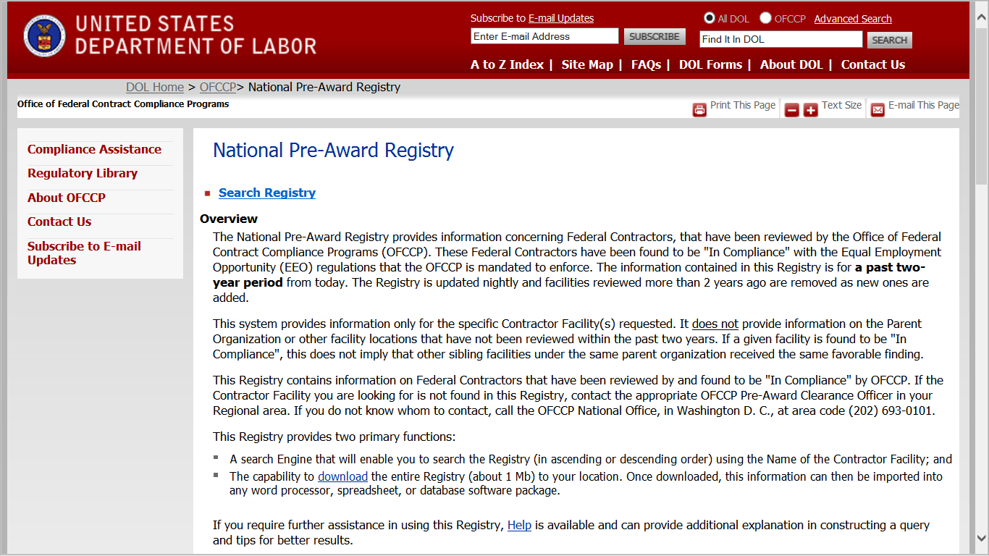
Solicitation
Pre-Award
Post-Award
Notes:
Speaker Notes:
This is a searchable database of contractors that have undergone a compliance evaluation and received a Notice of Compliance within the last 24 month period. If the proposed contractor is on this list, then you would document the registry review in your contract file.
When determining whether or not a prospective contractor is cleared, remember the clearance is for the specific contractor facility.
If the contractor facility you are looking for is not found in this Registry, then you will need to contact an OFCCP Pre-Award Monitor in the regional office where the contract will be performed. If you do not know who to contact, call the OFCCP National Office.
Next Slide: Question

Slide 27
Solicitation
Pre-Award
Post-Award
Question:
What about “option year” contracts? If the initial award is less than $10 million but the award’s option years could potentially meet the $10 million threshold, is pre-award clearance required?
OFCCP - An Update, February 18, 2015
Notes:
Speaker Notes:
Read the slide content.
Next Slide: Answer

Slide 28
Answer:
Solicitation
Pre-Award
Post-Award
Yes – consider the total value of the contract including any options to determine the $10 million threshold.
OFCCP - An Update, February 18, 2015
Notes:
Speaker Notes:
Read the slide content
Next Slide: Responsibilities: Requesting Preaward Clearance

Slide 29
Requesting Pre-Award Clearance
Solicitation
Pre-Award
Post-Award
Submit request at least 30 days before
Regional Office for the Place of Performance
Information Needed
Contact Information for the Proposed Contractor
Contact Information for Proposed Subcontractors
Anticipated Date of Award
Place of Performance
Estimated Dollar Amount
OFCCP - An Update, February 18, 2015
Notes:
Speaker Notes:
Contractors are encouraged to submit a pre-award clearance at least 30 days before the proposed award date.
Requests for EEO pre-award clearances can be sent by email to the regional office where the contract will be performed. The email addresses for each region is listed on our Web site. In the request, you are required to provide the following information:
Name, address, point of contact, and telephone number of the proposed contractor;
Name, address, point of contact, and telephone number of each proposed subcontractor(s) with a subcontract estimated at $10 million or more;
Anticipated date of award;
Information regarding whether the contractor and subcontractor(s) have previously held any Government contracts and subcontracts;
Place(s) of contract performance;
Estimated dollar amount of contract and each subcontract, if known;
OFCCP has 15 days after receiving the clearance request to inform the awarding agency of its intention to conduct a pre-award compliance evaluation. If the awarding agency is not informed, it may proceed with the award; if OFCCP states it will perform the evaluation, it is allowed an additional 20 days to do so.
Next Slide: Question

Slide 30
Solicitation
Pre-Award
Post-Award
Question:
Which regional office should I send the pre-award clearance request to?
OFCCP - An Update, February 18, 2015
Notes:
Speaker Notes:
Read the question on the slide.
Next Slide: Answer

Slide 31
Answer:
Solicitation
Pre-Award
Post-Award
It depends…
OFCCP - An Update, February 18, 2015
Notes:
Speaker Notes:
Read the answer on the slide.
If you have additional questions about a specific pre-award request, we encourage you to follow-up with the Regional Office where you made the request.
Next Slide: Post Award

Slide 32
Responsibilities of Federal Procurement Officers
Solicitation
Pre-Award
Post-Award
OFCCP - An Update, February 18, 2015

Slide 33
Post-Award
Solicitation
Pre-Award
Post-Award
Incorporating the Equal Opportunity Clauses into the Contract
Providing the EEO is the Law Poster
Referring Inquiries and Complaints to OFCCP
Notifying OFCCP of Construction Contract Awards
OFCCP - An Update, February 18, 2015
Notes:
Speaker Notes
Once a contractor is selected, Contracting officers are responsible for several significant actions related to EEO and affirmative action.
These are:
Incorporating the equal opportunity clauses into the contracts.
Providing the contractor with access to the appropriate notices for employees.
Referring Inquiries and Complaints to OFCCP
Notifying OFCCP of Construction Contract Awards
Over the next slides, we’ll review each of these obligations with you.
Next Slide: Equal Opportunity Clauses

Slide 34
Equal Opportunity Clauses
Solicitation
Pre-Award
Post-Award
Incorporate the Equal Opportunity (EO) Clauses in all nonexempt solicitations and contracts
The EO Clauses:
Prohibits Discrimination
Requires Affirmative Action
Requires Notification to Employees and Subcontractors
Provides Access to OFCCP
OFCCP - An Update, February 18, 2015
Notes:
Speaker Notes:
Each of OFCCP’s laws includes an Equal Opportunity Clause or EO Clause. These clauses can be incorporated individually into covered contracts and subcontracts or combined and incorporated.
The clauses are important as it sets forth for the contractor and their subcontractors the requirements and obligations related to federal contracting and subcontracting. The clauses prohibit discrimination, require affirmative action, and requires notice be given to employees, unions, and subcontractors.
The clauses also provide OFCCP access to the contractor’s facility or work site in the case of construction and clearly state that the contractor may not enter into a subcontract with a debarred contractor.
As we mentioned previously, the EO clauses were updated by the Section 503 and VEVRAA rules as well as by the recent amendments to Executive Order 11246.
Next Slide: Responsibilities: The EO Clause

Slide 35
EO Clause (Example)
Solicitation
Pre-Award
Post-Award
This contractor and subcontractor shall abide by the requirements of 41 CFR 60-1.4(a), 60-300.5(a) and 60-741.5(a). These regulations prohibit discrimination against qualified individuals based on their status as protected veterans or individuals with disabilities, and prohibit discrimination against all individuals based on their race, color, religion, sex, sexual orientation, gender identity or national origin. Moreover, these regulations require that covered prime contractors and subcontractors take affirmative action to employ and advance in employment individuals without regard to race, color, religion, sex, sexual orientation, gender identity, national origin, disability or veteran status.
OFCCP - An Update, February 18, 2015
Notes:
Speaker Notes:
On the slide is an example of a combined EO clause.
The revised Section 503 and VEVRAA regulations require more information specifying that the contractor is an Equal Opportunity Employer of protected veterans and individuals with disabilities. It’s a clearer message that lets a contractor’s subcontractors, vendors and suppliers know that they may now have requirements if they meet OFCCP threshold.
In addition, this clause includes the most recent amendment to EO 11246 which added sexual orientation and gender identity to the protected bases.
This example can be found on OFCCP’s Web site. Check the FAQ sections – Frequently asked questions.
Next Slide: EEO is the Law Poster

Slide 36

EEO is the Law Poster
Solicitation
Pre-Award
Post-Award
Provide Notices for Contractors
OFCCP - An Update, February 18, 2015
Notes:
Speaker Notes:
The EO Clauses indicates that the contracting officer will provide the contractor with the a notice for contractors to post. That notice is the EEO is the law poster. A new supplement is available through our website or EEOC’s website that can be provided along with the poster to reflect recent changes.
This poster can be found on OFCCP’s Web site or on EEOC’s Web site in a printable format.
The poster notifies employees and applicants that the employer is a federal contractor and advises them of their rights.
Next Slide: Referring Complaints

Slide 37

Referring Complaints
Solicitation
Pre-Award
Post-Award
Referral of inquires and complaints regarding status or violation of OFCCP laws to OFCCP regional office.
OFCCP - An Update, February 18, 2015
Notes:
Speaker Notes:
Another obligation of contracting offices is the referral of complaints. Complaints received by the contracting officer alleging violation of the requirements of any of the laws that OFCCP enforces should be referred immediately to the OFCCP regional office.
The complainant shall be advised in writing of the referral. The contractor that is the subject of a complaint shall not be advised in any manner or for any reason of the complainant's name, the nature of the complaint, or the fact that the complaint was received.
Next Slide: Responsibilities: Referring Inquiries

Slide 38
Referring Inquiries
Solicitation
Pre-Award
Post-Award
Inquiries from labor unions regarding the revision of a collective bargaining agreement in order to comply with any of OFCCP’s Laws
OFCCP - An Update, February 18, 2015
Notes:
Speaker Notes:
Similarly, inquiries from labor unions regarding the revision of a collective bargaining agreement in order to comply with any of OFCCP’s Laws should be referred to OFCCP regional office.
Next Slide: Responsibilities: Notification of Construction Awards

Slide 39

Notification of Construction Awards
Solicitation
Pre-Award
Post-Award
Contracting officers are required to give written notice to OFCCP within 10 working days of an award of a construction contract or subcontract in excess of $10,000
OFCCP - An Update, February 18, 2015
Notes:
Speaker Notes:
The incorporation of the EO Clauses, EEO is the Law poster, and referral of any inquiries and complaints apply to all federal contractors and subcontractors. The notification of award for construction contracts and subcontracts in excess of $10,000 is unique to construction contracts.
Generally, construction contracts are contracts for the mitigation, remediation, construction, or rehabilitation of a physical structure.
So, when making such an award, written notice must be given to the appropriate OFCCP regional office within 10 working days of the award of a construction contract or subcontract of $10,000 or more subject to affirmative action requirements.
Next Slide: Content of Notification

Slide 40
Content of Notification
Solicitation
Pre-Award
Post-Award
This notification of a construction award should include:
Name, address, telephone number of contractor
Employer Identification Number
Dollar amount of contract; Contract number
Estimating starting and completion dates
Geographical area(s) in which work will be performed
OFCCP - An Update, February 18, 2015
Notes:
Speaker Notes:
This notification of a construction award should include:
Name, address, telephone number of contractor
Employer Identification Number
Dollar amount of contract; Contract number
Estimating starting and completion dates
Geographical area(s) in which work will be performed
Next Slide: Key Take Aways

Slide 41
Key Takeaways
Significant Role in Ensuring EEO and Affirmative Action in Federal Contracting
Incorporate Equal Opportunity clauses from the three regulations in solicitations
Contracting officers must check the pre-award registry and SAM for contracts that meet the threshold
OFCCP as a Resource
OFCCP - An Update, February 18, 2015
Notes:
Speaker Notes:
This concludes the formal portion of our training on EEO responsibilities of federal procurement officers.
As contracting officers you play a significant role in ensuring federal contractors are aware of their equal employment opportunity and affirmative action obligations. Your responsibilities are important at the solicitation, pre-award, and award of the contract.
It is very important that the Equal Opportunity Clauses that you are using are up to date and incorporated into all covered federal contracts and subcontracts.
You must also ensure that contractors receive all of the support and tools (i.e., posters, EO clauses, etc.) to ensure their success.
Next Slide: Contact Information

Slide 42
Contact Information
Website:
http://www.dol.gov/ofccp
Help Desk:
(800) 397-6251
Notes:
Speaker Notes: Brenda
Thank you so much Melissa and Herman. I’m sure the information presented today will generate a lot of questions or comments from our audience. We’ll conclude the presentation portion of today’s session and start providing responses to the questions that have come in.
We will leave this slide up, and take your questions.
End of the Presentation

